Slide 1
Gender Based Violence GBV

Slide 2
What is gender based violence?
Violence that is directed against a woman because she is a woman or that affects women disproportionately.
This does not mean that all violent acts against a woman are gender-based violence, or that all victims of gender-based violence are female.

Slide 3
Gender & sex
GBV, Intimate partner violence & Domestic violence

Slide 4
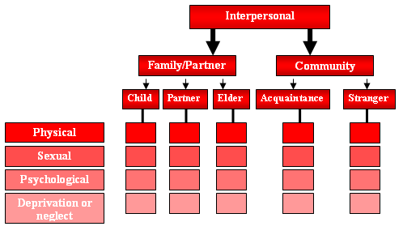
Types of Interpersonal Violence

Slide 5
Violence is a means of control and oppression that can include emotional, social or economic force, coercion or pressure, as well as physical harm. It can be overt, in the form of physical assault or threatening someone with a weapon; it can also be covert, in the form of intimidation, threats, persecution, deception or other forms of psychological or social pressure.

Slide 6
Cause of violence?
Human behavior arises from free will?
Human behavior is determined by external factors?
Complex & multifaceted problem
Causes –
Psychological
Interpersonal
Structural factors

Slide 7
Declaration on the Elimination of Violence against Women (UN 1993)
Women are entitled to the equal enjoyment and protection of all human rights ....
These include, the right to:
life
equality
liberty and security of person
equal protection under the law
be free from all forms of discrimination
the highest standard attainable of health
just and favourable conditions of work
not to be subjected to torture, or other cruel, inhuman or degrading treatment or punishment

Slide 8
Types of GBV
Physical
Sexual
Psychological
Deprivation
Actual or threats

Slide 9
Settings
Homes
Workplaces
Educational establishments
Public transport
Other public spaces

Slide 10
Magnitude of the problem
One in three women affected?
Risk groups
age
marital status
educational level
occupation

Slide 11
Violence and Coercion within Romantic Relationships among University Students
Violence and coercion within romantic relationships were studied in 2011 using a sample of 283 female university students.
Thirty six per cent of students surveyed reported instances where girls were forced to commence a romantic relationship and 73% of girls said they were forced to continue relationships.
Chathurangana P. Romance, sex and coercion: insights into undergraduate relationships. Sri Lanka J Psychiatry. 2011;2(2):54–9

Slide 12
Causes/ Associated factors
Individual
Family
Community
Cultural
Legal

Slide 13
Gender Equitable Man
seeks relationships with women based on equality, respect and intimacy rather than conquest;
seeks to be involved in household duties and childcare, reflecting acceptance of financial and care-giving responsibilities towards children and the household;
assumes some responsibility for sexually transmitted infection prevention and reproductive health in their relationships;
opposes violence against women under all circumstances; and
opposes homophobia and violence against homosexuals.

Slide 14
 | Men | Women
A woman’s most important role is to take care of her home and cook for her family | 57.4 | 66.9
There are times when a woman deserves to be beaten | 26.4 | 37.5
It is a woman’s responsibility to avoid getting pregnant | 31.9 | 54.3
A woman should tolerate violence in order to keep her family together | 40.6 | 58.0
To be a man, you need to be tough | 57.0 | 57.2
Broadening gender: Why masculinities matters

Slide 15
Knowledge and Attitude of women, men and community
W M
- Understanding of GBV Weak Weak
- Understanding that GBV
prevention is a fundamental right Weak Weak
- Understanding of root causes of GBV Weak Weak
- Community acceptance of male dominance Strongly Positive
- Community perception that violence is
acceptable in married life Strongly Positive
*Women (W) and Men (M)

Slide 16
Source: UN multicountry study on men and violence

Slide 17
Interventions
Prevention as well as response (dealing with victims)
Individuals & families
Groups/ communities
Countries
International

Slide 18
Role of Doctors
Detect/ identify
Treat victims
Inform society about the burden
Incidence & lifetime prevalence
Effect on the victims
Effect on children
Prevention?

Slide 19
GBV Summary
Terms & definitions
Types
Settings
Magnitude
Causes
Interventions

Slide 20
aluta continua (The struggle continues) By Roshila Nair
let's say it out loud about the other day how we were talking about that Comrade X who went home and gave his wife a blue eye, and we'd all clapped an hour before for the liberation speech he gave with such conviction.

Slide 21
Violence is a means of control and oppression that can include emotional, social or economic force, coercion or pressure, as well as physical harm. It can be overt, in the form of physical assault or threatening someone with a weapon; it can also be covert, in the form of intimidation, threats, persecution, deception or other forms of psychological or social pressure.

